Slide 1
HPJava Language Binding in relation to HPPython
Authors: Joshua DeNio, Heecheon Park

Slide 2
Structured SPMD Programming
The language will have single thread control on organized process groups. Only the data owners will have the ability to share the current control of the thread when data is being accessed
Special constructs will aid in making well defined mechanisms to control data access..

Slide 3
Global name space
The global namespace provides a data descriptor to relieve problems caused by potential local-to-global and global-to-local translations.

Slide 4
Collective Communication
A collective communication library will provide an interface to allow data access to different process groups. It will be designed to encourage programmers to write algorithms to exploit locality.
Communication will be based on the SPMD style.

Slide 5
Language Binding
Process groups will be the foundation of the languages functionality as a SPMD platform.
A new class called Group will represent the process group
Each Group will have a set of process dimensions that will define the process grid.

Slide 6
Example:
P1 = Group(2,4)
Where P1 is the variable name of a 2 X 4 dimensional process grid.

Slide 7
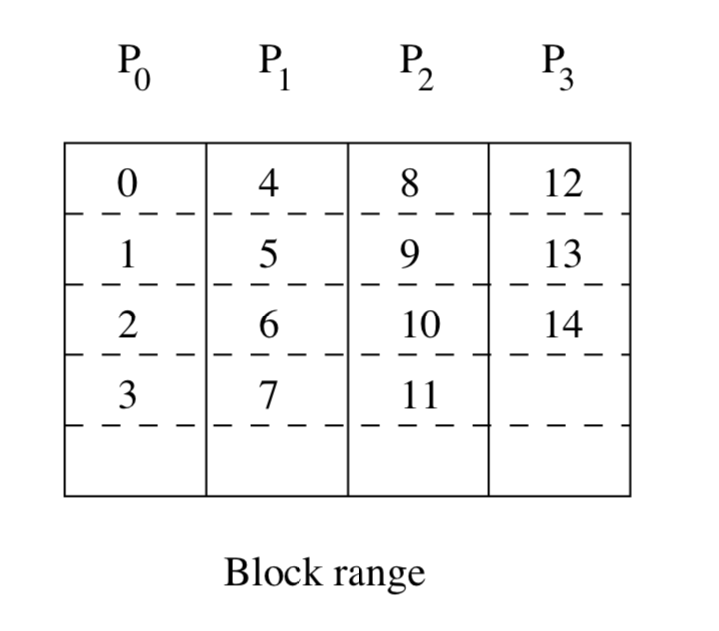
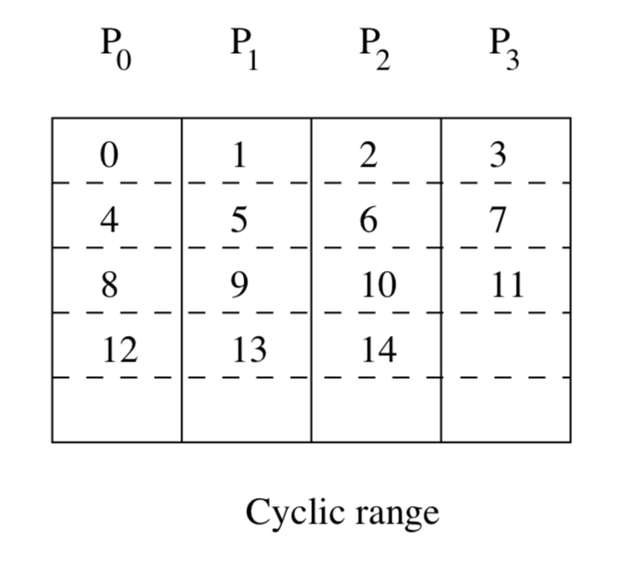
Each Group will have both a BlockRange and a CyclicRange
X = BlockRange(100, P1.dim(0))
Y = CyclicRange(200, P1.dim(1))
Will create two ranges on different process dimensions of Group P1 . One is block distributed and the other is Cyclic distributed.

Slide 8
Subgroup and Subrange
A subgroup is a segment of the process array created by restricting the process coordinates in one or more dimensions to single values.
This will allow access to specific segments of the array.

Slide 9
Subgroup and Subrange
Subgroup and Subrange override the “ |” symbol and the “ /”
To represent slices of a data set.
The “:” is used to create a triplet such as x | 1 : 49
To designate a specific location within the slice.

Slide 10
On(veriableName):
The On() command defines the Process group that will be allowed to work . the veriableName passed in is the active process Group that will gain permission to work.
For example, on(p) int # s = new int #; # s = 100; will create a global variable shared by the distributed processors.

Slide 11
The # symbol in relation to scalar global variables
Since the python language uses the # symbol to represent a comment line we will have to invent a new keyword to take its place so as not to confuse python users who are used to using the # symbol in a normal context.

Slide 12
OverAll():
OverAll() is functionally a nested loop that iterates over a set of active process groups. // Location i = x[1]; on(q) for (int n = 0; n < 4; n++) at(i=x[n]) a[i]=3; on(q) overall(i = x|0:3) a[i]=3;

Slide 13
Referances:
Guansong Zhang, Bryan Carpenter, Geoffrey Fox, Xinying Li, and Yuhong Wen. Structured SPMD programming - Java language binding. October 1997

